Slide 1
CNN = Feature extraction + Classification

Slide 2
CNN
Though convolutional neural networks were introduced to solve problems related to image data, they perform impressively on sequential inputs as well.
It is mainly used for image classification
The building blocks of CNNs are filters a.k.a. kernels. Kernels are used to extract the relevant features from the input using the convolution operation.
Formula
o/p = n – f +2p / s + 1

Slide 3
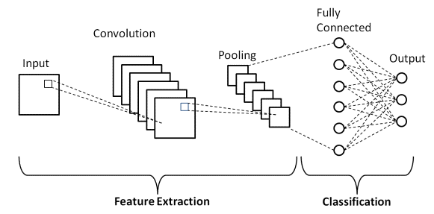
Layers of CNN
1)Convolution
2)Pooling
3)Fully connected layer

Slide 4
1)convolution
It takes 2D input
Extracting features from images.
The output from convolution is called feature map
Components of convolution :
i)Filter
ii)Stride
iii)Padding
In convolution,
i/p image * number of filter = o/p (feature map)

Slide 5
To find parameters in convolutional layer ?
Formula
(shape of width of filter * shape of height of filter * number of filter in previous state +1) * number of filter

Slide 6
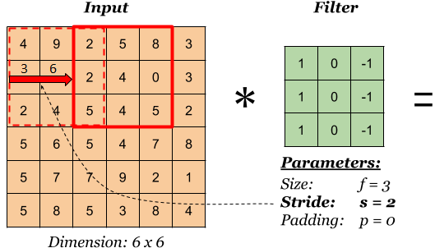
i)Filter
Filter used to extract the features from the images.
Researchers decides kernel values.
It is called as mask / kernel /Feature detection / Feature extractor.
Filter moved on entire image.
We need to choose ,
i) Size of filter
ii) Number of filter

Slide 7
ii)Stride
Stride is the number of pixels shifts over the input matrix.
So moving your kernel one position is called stride.
We need to choose ,
i)Stride 1 (default)
ii)Stride 2

Slide 8
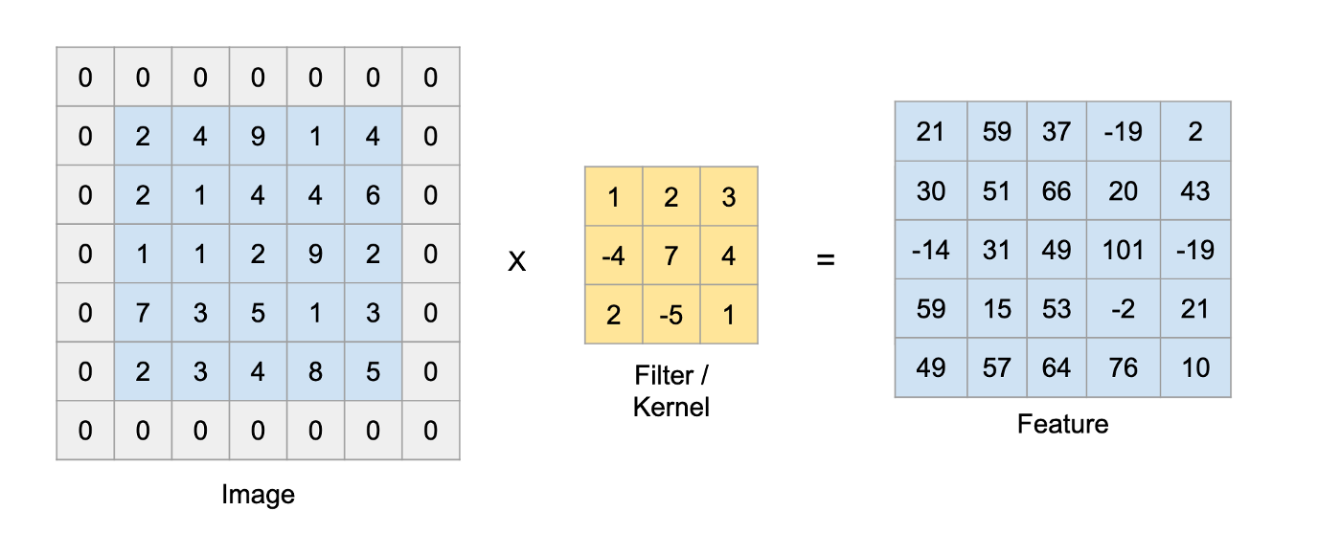
iii)Padding
Adding a extra layer that contain zeros.
If you add padding to original image then you get same size of output image.
Types -> i)Valid padding (default) , ii)Same padding

Slide 9
2)Pooling
Reducing dimension of images
It get input from convolution layer
Types of Pooling Layers:
i)Maximum pooling
ii)Minimum pooling
iii)Average pooling

Slide 10
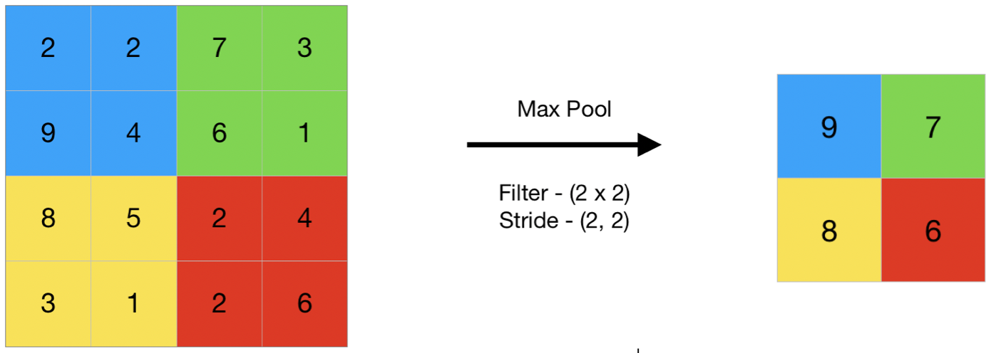
i)Maximum pooling
Max pooling is a pooling operation that selects the maximum element from the region of the feature map covered by the filter.

Slide 11
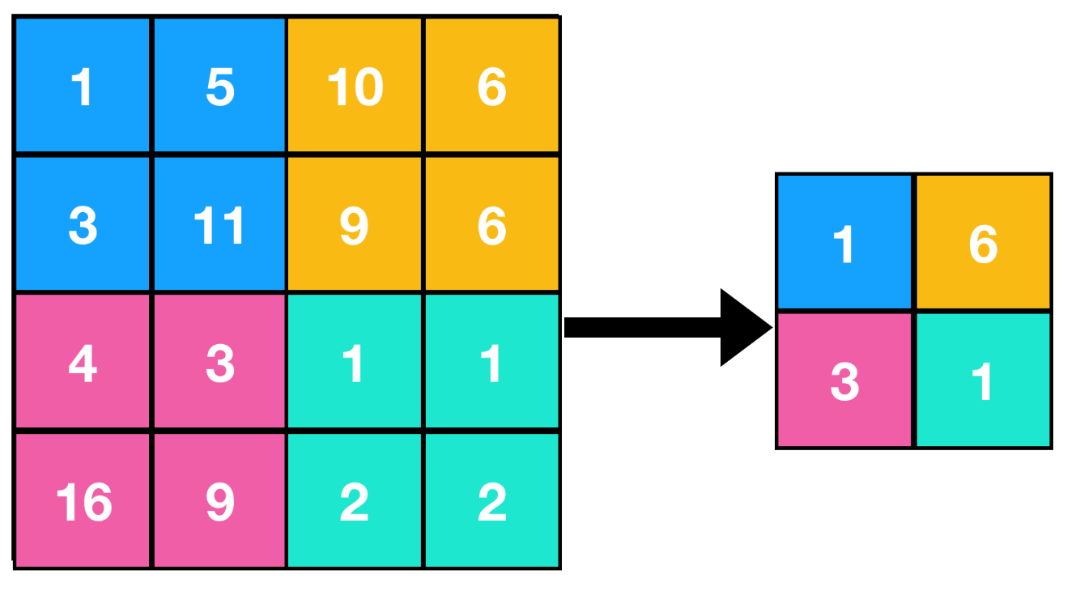
ii)Minimum pooling
Min pooling is a pooling operation that selects the minimum element from the region of the feature map covered by the filter.

Slide 12
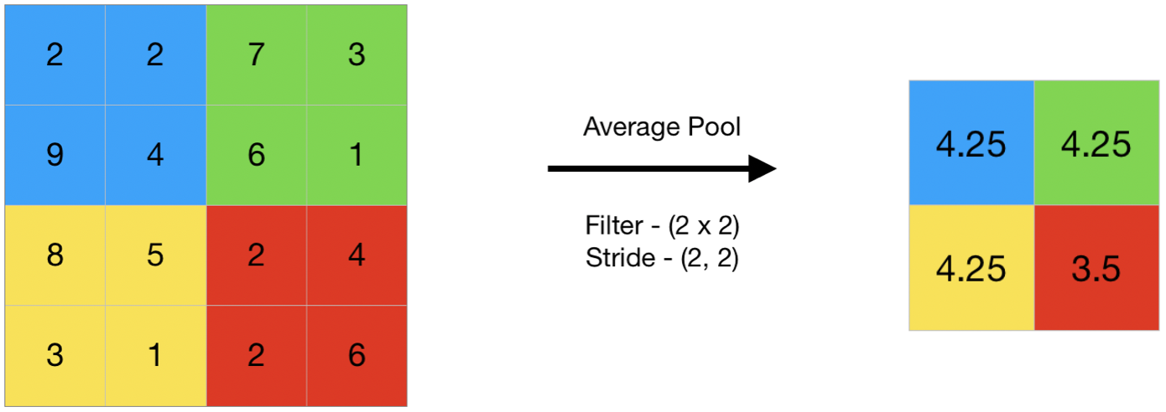
iii) Average Pooling
Average pooling computes the average of the elements present in the region of feature map covered by the filter.

Slide 13
3)Fully connected layer (ANN)
It is a multi layer perceptron . We know it contains weight & bias and input layers , hidden layers .
It is used for classification in CNN architecture.
It gets a input from pooling layer

